Slide 1
SpendWise
HACKATHON PROJECT | PROBLEM STATEMENT 49
TEAM MEMBERS:
G. RUTHIKA
CH. RUPA
D. GNANESHWARI
M. SREEJA
Expense Management built on the MERN stack
A secure tracker to add, view, update and manage expenses by date, category, amount and description, with role-based admin control.
Problem domain
Personal and team finance management
Notes:
Introduce SpendWise: an expense management system built on MERN for Problem Statement 49. Fill in team name and members.

Slide 2
The Challenge
1
The problem
2
Why it matters
3
Key challenges
Spending is recorded in scattered notes, receipts or memory
Records lack a consistent structure
Hard to see where money actually goes
Poor visibility makes budgeting guesswork
Small untracked costs add up unnoticed
Shared or team spending needs oversight
Capture date, category, amount and description reliably
Keep each user's data private
Give admins control without exposing users' data
Notes:
Frame the real-world problem: people lose track of spending. Stress structured records, privacy and admin oversight.

Slide 3
Our Innovation
CORE IDEA
1
2
One secure place to record every expense, with a clear dashboard and role-based control.
Full CRUD
Secure login
Add, view, update and delete expenses
Hashed passwords and JWT sessions
3
4
Different because it is simple, focused and secure by default.
Role-based access
Smart dashboard
Users see their own data; admins manage users
Totals, category split and monthly trend
Notes:
Core idea and four key features. The first registered user automatically becomes admin.

Slide 4
How It Works
Input
Processing
Algorithm
Output
User logs in, then enters an expense: title, amount, category, date, description
React validates the form; Express checks the JWT and role; Mongoose validates the schema
bcrypt and JWT secure access; totals and filters are computed over the user's records
Expense saved in MongoDB; dashboard, charts and filtered lists update
Every request after login carries a JWT, so the API always knows who is asking and what they may do.
Notes:
Walk through Input, Processing, Algorithm, Output. The note at the bottom explains how auth ties the flow together.

Slide 5
Technology & Algorithm
TECH STACK
ALGORITHMS AND PURPOSE
React.js
user interface
Algorithm | Purpose | Complexity
bcrypt hashing (10 salt rounds) | Store passwords as salted hashes | Deliberately slow; cost doubles per extra round
JWT sign and verify (7-day expiry) | Stateless login; identify user and role | O(1) per request
Role check (admin or user) | Restrict admin-only routes | O(1)
Category totals, search, filter | Dashboard summary and lists | O(n) over the user's expenses
Unique email index | Prevent duplicate accounts | O(log n) index lookup
Node.js + Express
REST APIs
MongoDB + Mongoose
data and schemas
JWT + bcryptjs
authentication
CORS
frontend-backend access
Notes:
Only algorithms present in the code are listed: bcrypt, JWT and role checks are in the backend. Totals and filters run in the prototype UI and will move to the API.

Slide 6
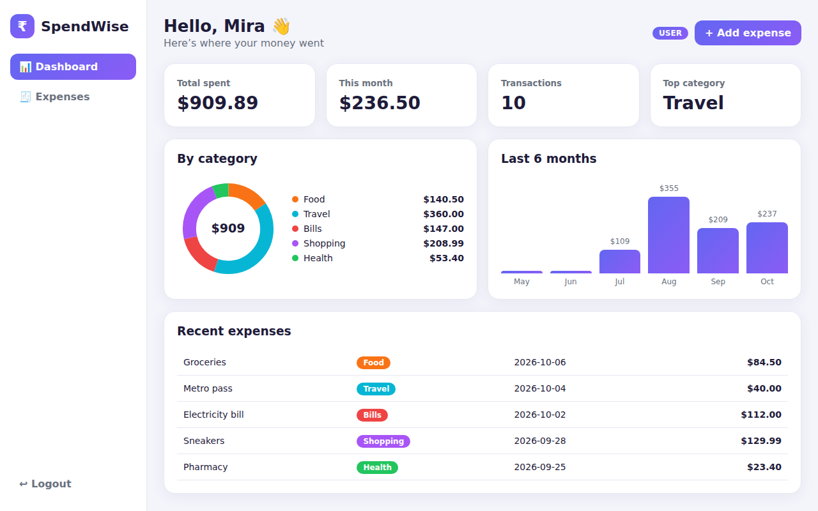
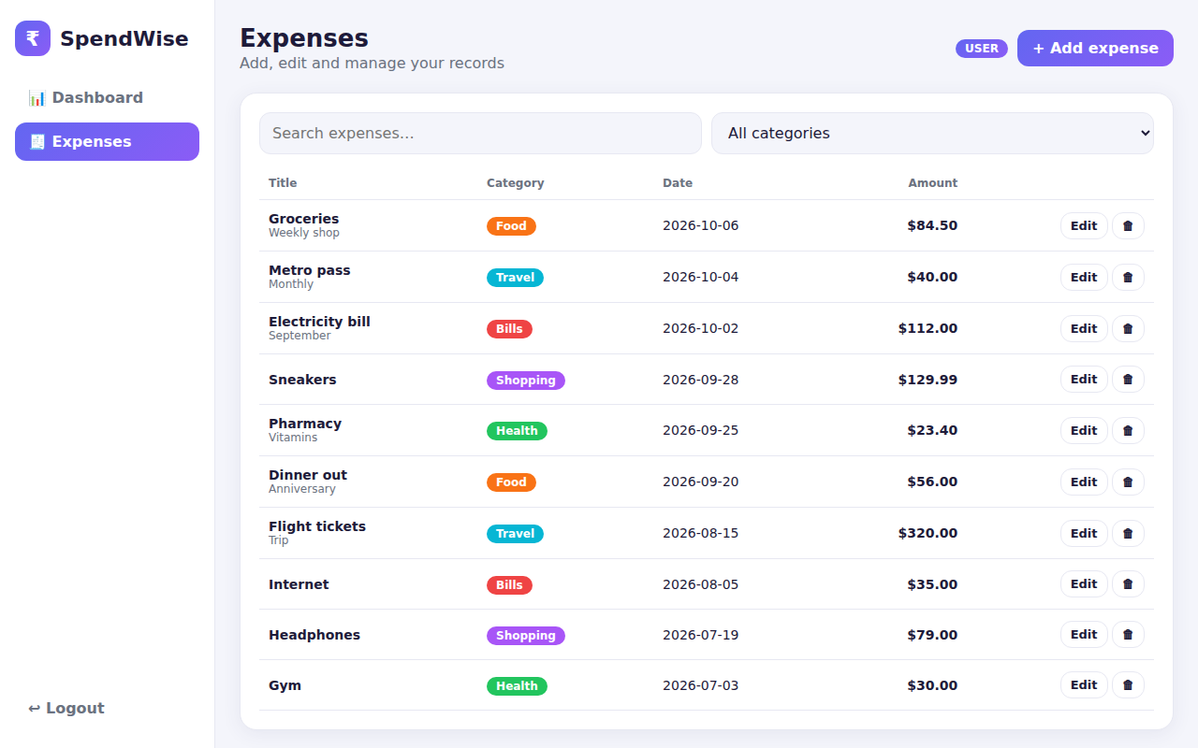
Demo & Impact
SAMPLE INPUT
Groceries, 84.50, Food, 2026-10-06
SAMPLE OUTPUT
New row in the list; Food total and dashboard update
Dashboard
Expenses (CRUD)
Clear visibility
Private by design
Admin oversight
See spending by category and month
Users see only their own records
Admins manage users and roles
Notes:
Screenshots are from the working UI prototype running on sample data. Auth APIs are implemented in the backend; expense endpoints are next.

Slide 7
Vision
1
Achieved
2
Next steps
3
Scalability
Register and login APIs
JWT auth with 7-day expiry
Role-based access (admin, user)
Working UI prototype
Expense CRUD REST endpoints
Connect React to the API
Move the JWT secret to an environment variable
Reports and budgets
Stateless JWT works across multiple servers
MongoDB indexes keep lookups fast as data grows
Thank You
Notes:
Recap what is done, what is next and why the design scales. Invite questions.

